Slide 1
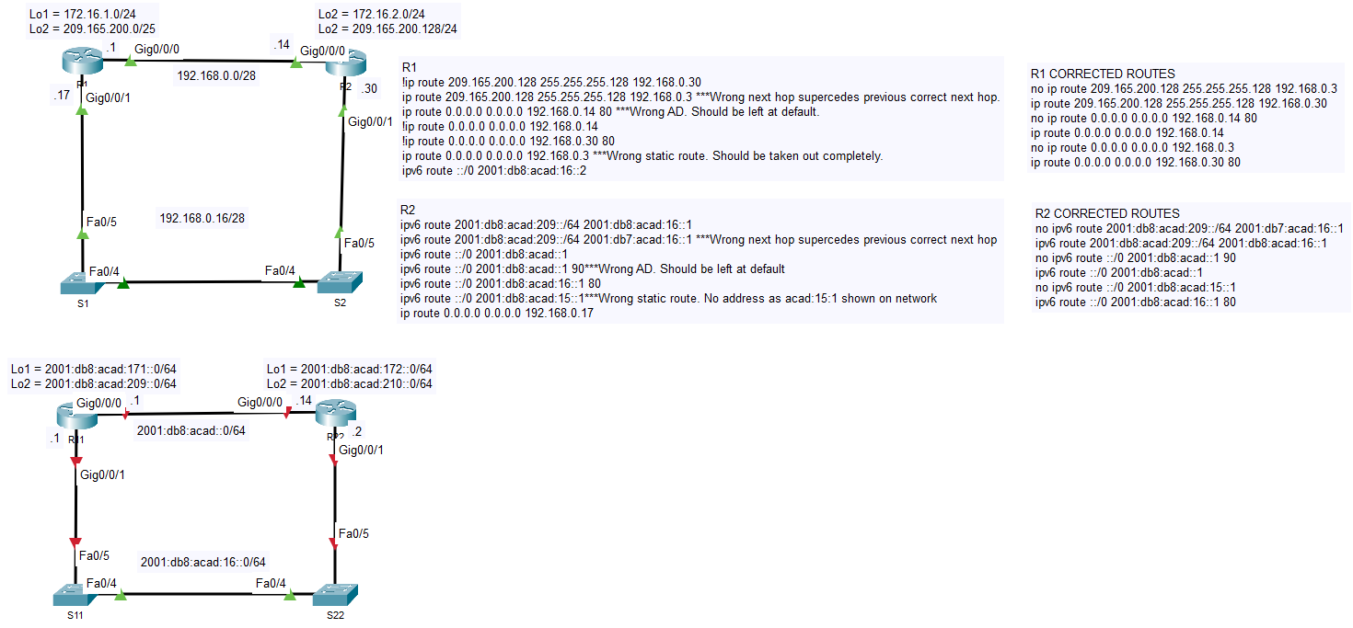
16.3.2 Lab - Troubleshoot IPv4 and IPv6 Static and Default Routes - ILM

